Slide 1

Four Mile Run
Stormwater Improvement Project
15 September 2020 Project Update

Slide 2


Welcome and Introductions
Alex Sciulli, P.E.
Chief of Program Management
Jim Turner, P.E.
Project Manager
Tony Igwe, P.E.
Wade Trim – Project Manager
Kari Mackenbach, CFM, ENV SP
ms consultants – Hydraulic modeling
Mallory Griffin, P.E.
JMT – Stormwater Pipeline Design
Tim Nuttle, PhD
CEC – Panther Hollow Lake and Junction Hollow Design
Pat Sullivan, P.E.
CEC – Panther Hollow Lake and Junction Hollow Design

Slide 3
Today’s Agenda
6:30pm – 8:00pm
1: PWSA’s Mission and this Project’s Goals 2: Four Mile Run Stormwater Improvements
3: Enhanced Modeling and Flood Mitigation Benefits 4: Four Mile Run Connection to Monongahela River
5: Project Schedule and Costs 6: Questions and Answers
3

Slide 4
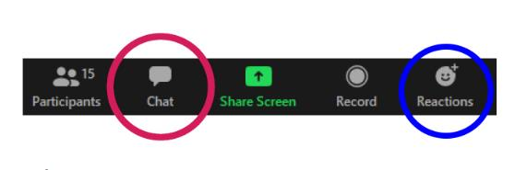
Submitting Questions Using Zoom
During Presentation
Participants will be muted
To ask a question use the chat box below
We will pause between sections to answer clarifying questions about information presented on slides
Click the Chat Icon
Located bottom of screen
Looks like cartoon bubble
Type question in dialogue box; press enter to send
All attendees will receive your question
Raise hand if need to interject
When presentation ends
We will respond to questions individually
We will unmute microphones to enable verbal Q&A
For more information or to ask a question after the meeting, please visit www.pgh2o.com/4mr
4

Slide 5

1
PWSA Mission and this Project's Goals

Slide 6
PWSA’s Mission
ORIGINAL MISSION:
PWSA’s mission was originally limited to providing drinking water to Pittsburgh’s homes and businesses, and to providing conveyance of wastewater through the sewer system to ALCOSAN’s treatment facilities.
TODAY:
Successful stormwater management requires participation from government, residents, businesses, and non-profits.
As the problem has grown in scale and in intensity, PWSA identified a need and has taken the initiative to address the impacts of stormwater.
PWSA’s 2016 Green First Plan identified projects and programs, including the Four Mile Run project, that can have a positive impact.
6
6

Slide 7
“Creating healthy,
flood-prepared neighborhoods”
PROJECT GOALS AND BENEFITS:
Reduce Combined Sewer Overflows
Reduce Flood Risk and Basement Backups
Manage Sediment
Leverage Resources for Regional Benefit
7
7

Slide 8
2
Four Mile Run Stormwater Improvements

Slide 9
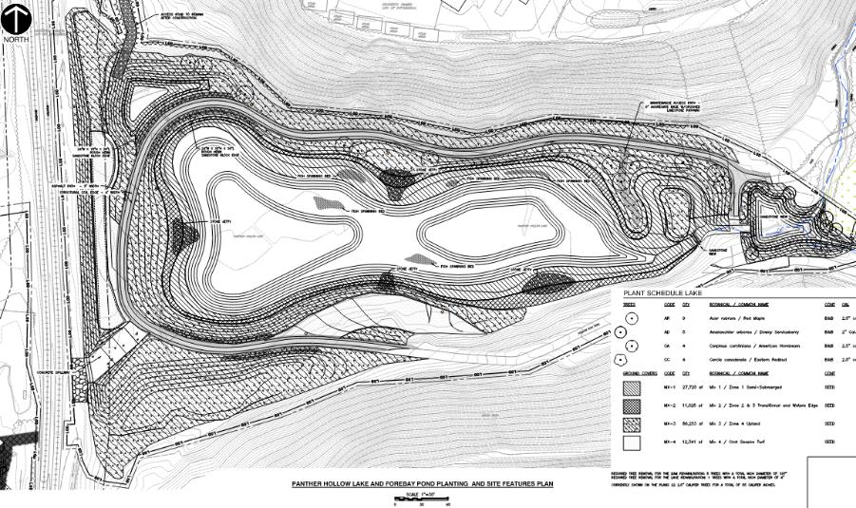
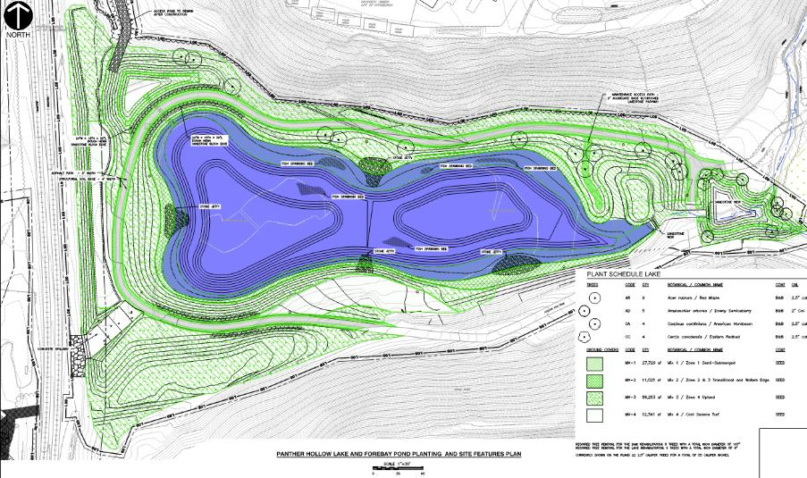
Panther Hollow Lake – Plan of Features
Forebay Pond and Pretreatment Wetland
Trail
Jetty
Lake Dredging
9

Slide 10
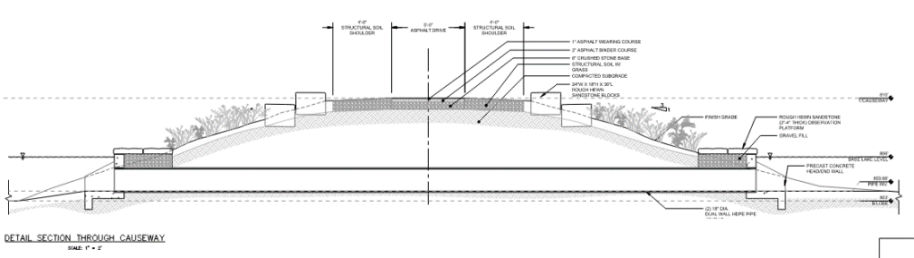
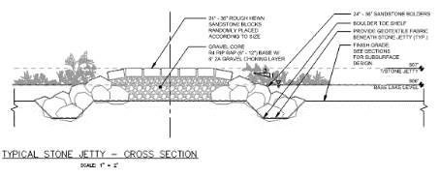
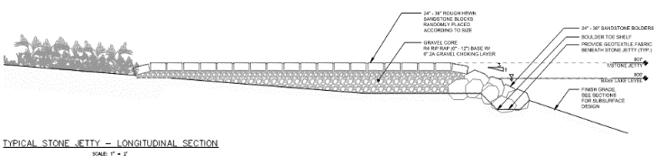
Panther Hollow Lake – Embankment Trail
13 ft. Wide Trail
Jetty
10

Slide 11
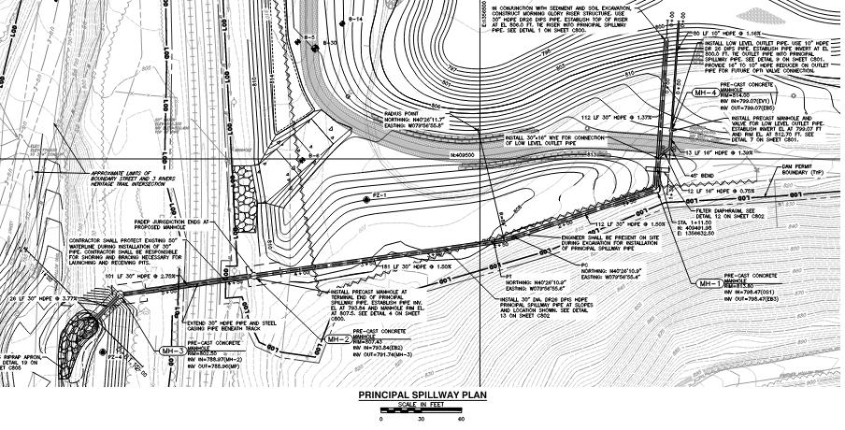
Panther Hollow Lake – Storm Control
Emergency Spillway
Principal Spillway Pipe
11

Slide 12
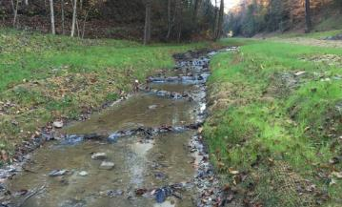
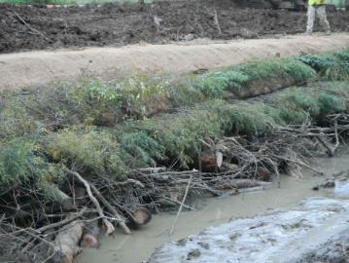
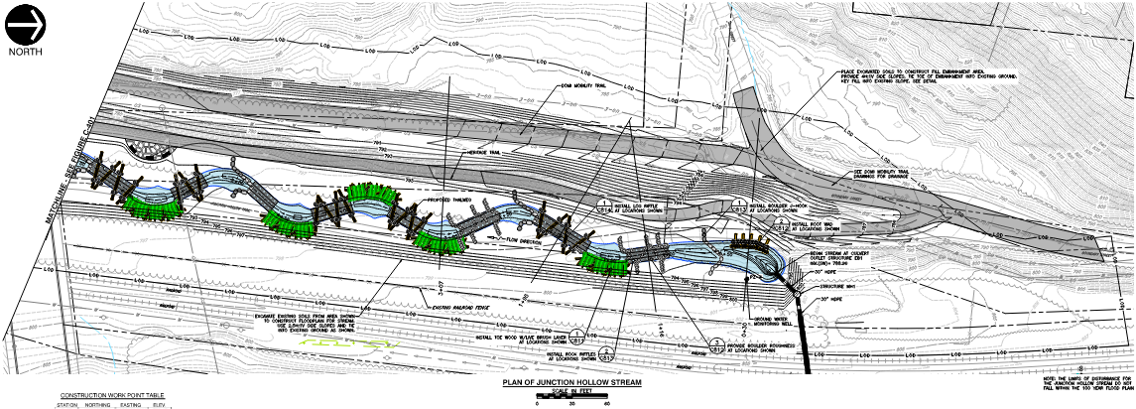
Junction Hollow-Across RR Tracks from PHL
^{LOG RIFFLE}
TOE WOOD WITH LIVE BRUSH LAYERING
12

Slide 13
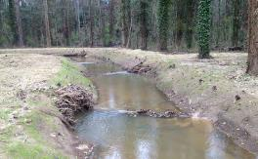
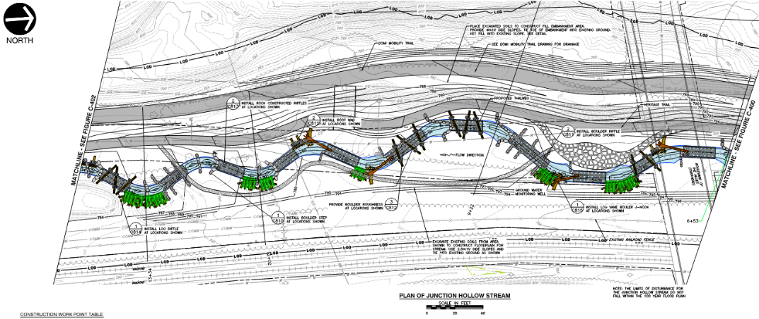
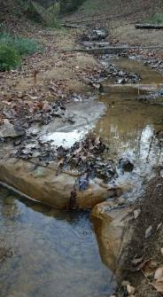
Junction Hollow-South of Allies Bridge
^{ROOT WAD}
^{BOULDER STEP POOL}
13

Slide 14
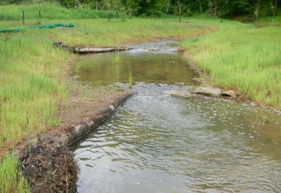
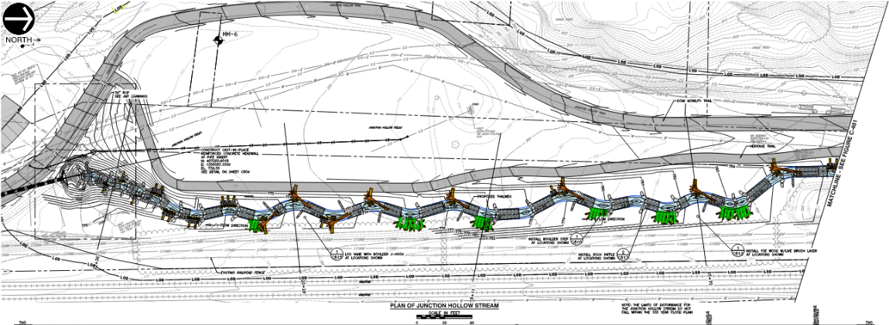
Junction Hollow-at the Soccer Field
LOG VANE, ROCK J-HOOK AND ROOT WAD
14

Slide 15
3
Enhanced Modeling and Flood Mitigation Benefits

Slide 16

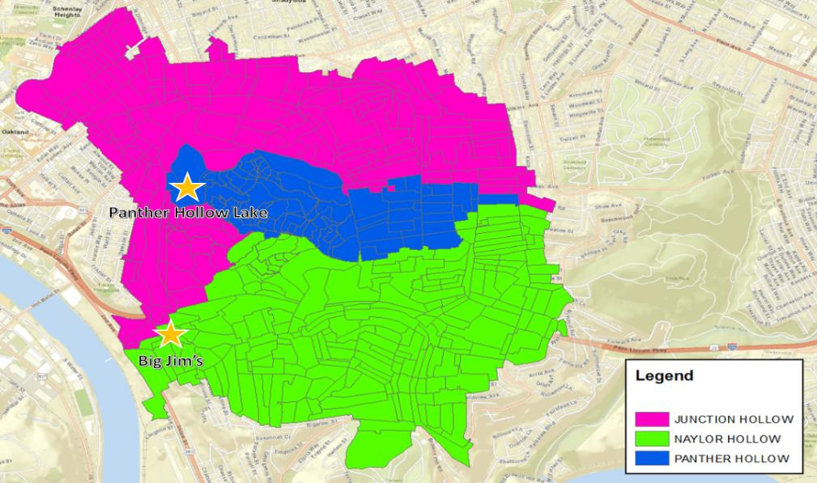
Four Mile Run Sub-Watersheds
16
Notes:
All three of these subwatersheds contribute to the Big Jims flooding.

Slide 17
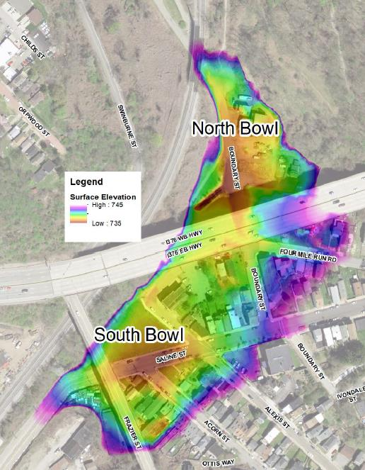
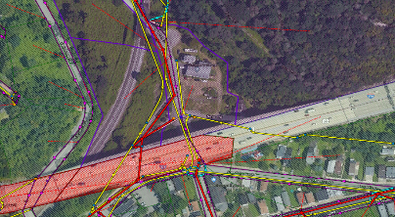
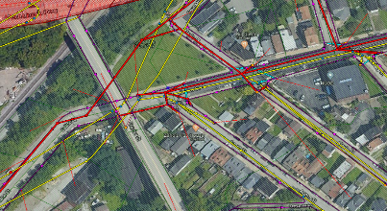
Points of Interest
North Bowl flooding-Boundary Street
South Bowl flooding - (near Big Jim’s)
17
Notes:
Dual Drainage Model afforded us the best look at how and why areas within 4 Mile were flooding. There are three areas of concern: South Bowl, North Bowl and the neighborhood directly impacted by the Naylor/Saline overland flooding.

Slide 18
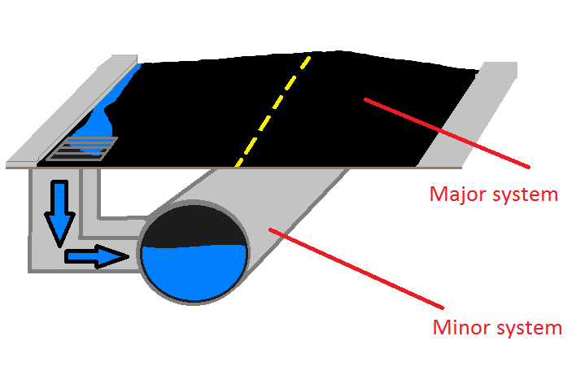
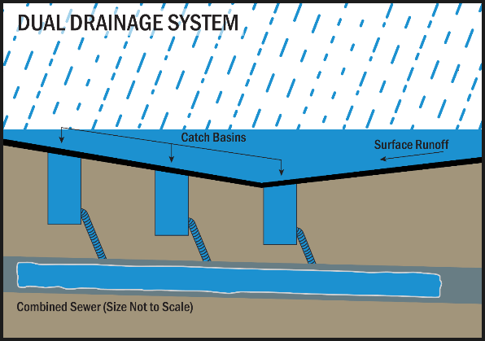
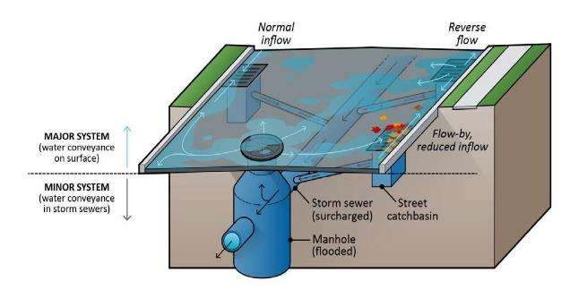
Dual Drainage Model Development Process
18
Notes:
Best Available Information and new technology allowed us to use a Dual Drainage Model. I will explain what the dual drainage model does as far as a benefit to our process.

Slide 19
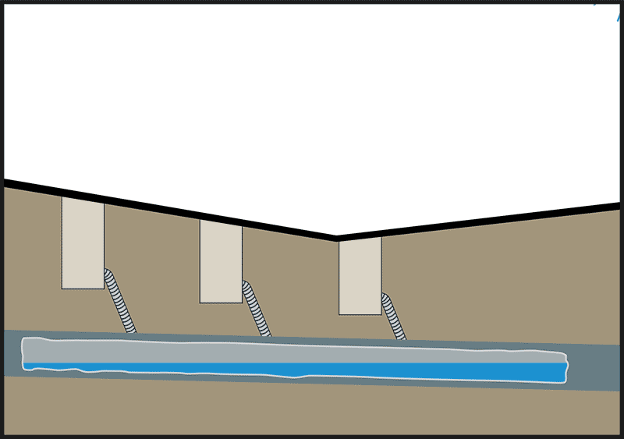
Dual Drainage Animation
19
Notes:
Best Available Information and new technology allowed us to use a Dual Drainage Model. I will explain what the dual drainage model does as far as a benefit to our process.

Slide 20
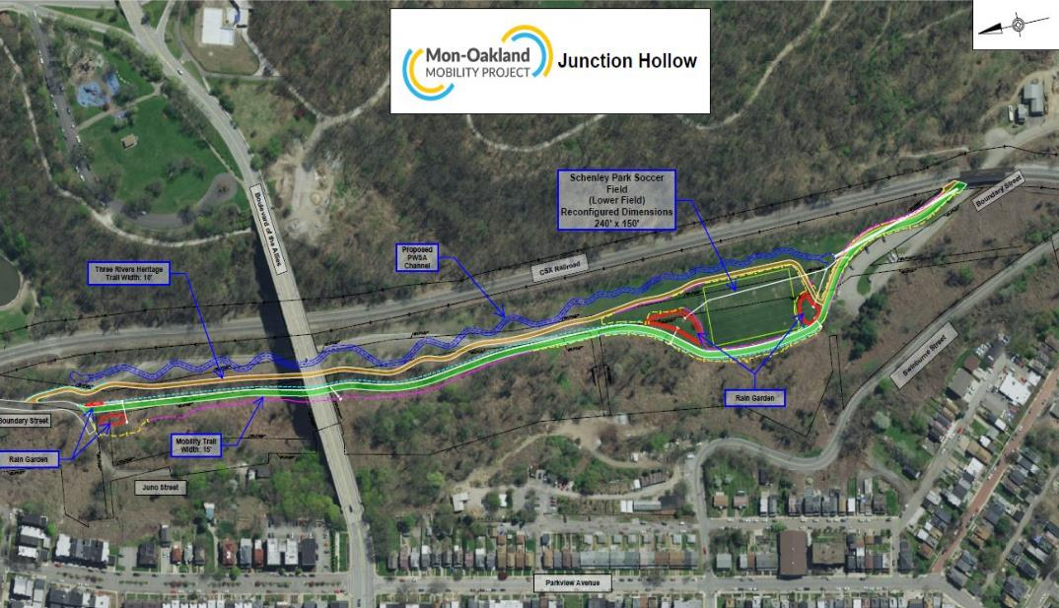
Mon-Oakland Mobility Trail Stormwater Project
20
Notes:
Best Available Information and new technology allowed us to use a Dual Drainage Model. I will explain what the dual drainage model does as far as a benefit to our process.

Slide 21
4MR Flood Mitigation Results
No change in the % reduction of structures at risk after incorporating the Mon-Oakland
Mobility Corridor project due to incorporation of stormwater best management practices
within the project
21
Notes:
Best Available Information and new technology allowed us to use a Dual Drainage Model. I will explain what the dual drainage model does as far as a benefit to our process.

Slide 22
4
Four Mile Run Connection to Monongahela River

Slide 23
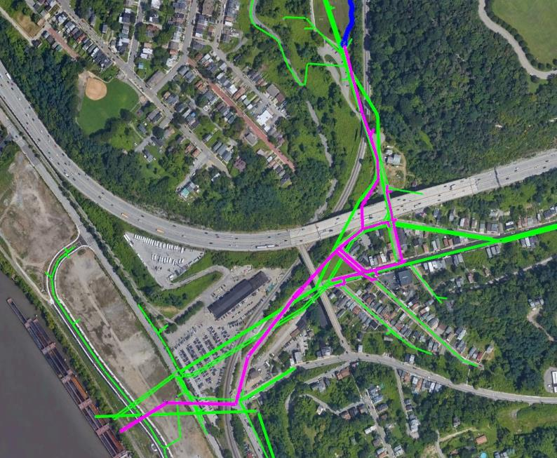
Stormwater Pipeline Project Limits
New 36-Inch
Storm Pipe at
New Stream Outlet
Schenley
Park
N
Challenges:
- topography
- utilities
- railroads (CSX & AVRR)
- highways
- bridges
Existing Large
Sewer Trunklines
I-376
Saline Street
2nd Avenue
Big Jim’s
Existing M29
Sewer Outfall
Map Legend
Existing Combined Sewer
Proposed Storm System
ALMONO
Greenfield Avenue
Monongahela River
New 60-Inch
Storm Outfall

Slide 24
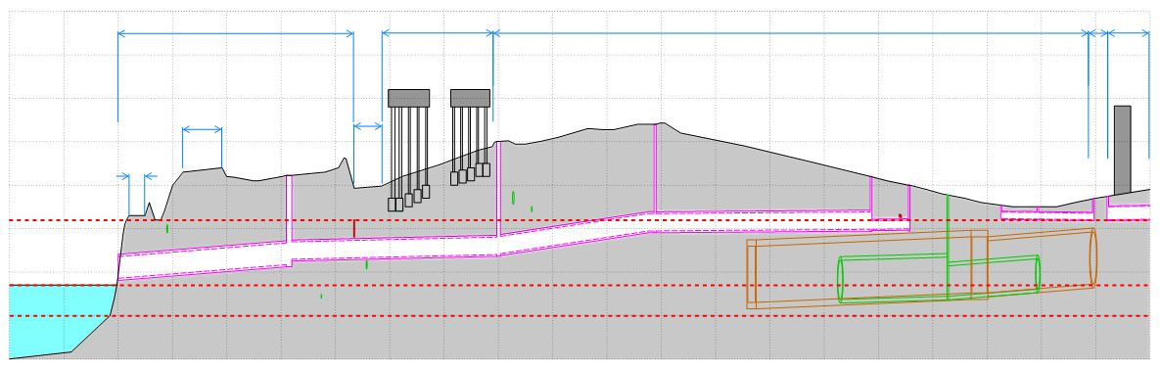
New Storm Profile
Monongahela River to Big Jim's on Saline St.
Alexis Street
780
770
760
750
Saline
Street
Almono
Greenfield Ave.
Saline Street
780
770
760
750
Overhead
Parking
Overhead
Railroad
Second Avenue
Big
JIm's
Blair
Street
Railroad
740
730
720
710
700
Low Lying
Area
740
730
720
710
700
100 Yr. Flood Elev. 732.0
Monongahela
River
Ex. 168" Sewer
Ex. 144" Sewer
Ordinary High Water Elev. 717.0
Normal Pool Elev. 710.0
Ex. 108" Sewer
Ex. 84" Sewer

Slide 25
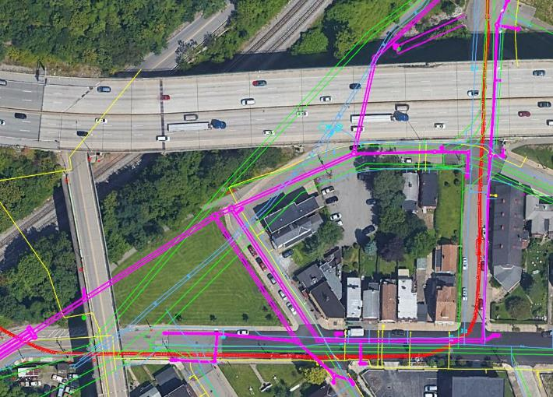
Major Utility Challenges
Saline Street / Alexis Street / Boundary Street
N
I-376 WB
I-376 EB
Map Legend
Proposed Storm
Existing Sewer
Existing Water
Existing Electric
Existing Gas
Ex. 84" Sewer
Four Mile Run Road
Ex. 50" Water
Frazier Street
Ex. 144" Sewer
Boundary Street
Alexis Street
Big Jim’s
Four Mile Run Park
Saline Street
Acorn St.

Slide 26
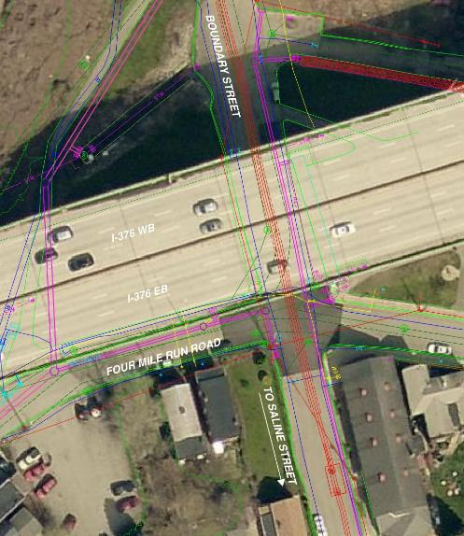
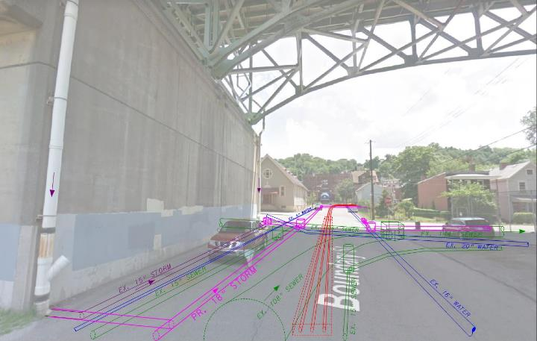
Disconnection of I-376– Boundary Street
N
Major 345 kV Electric Lines MUST be Avoided
Existing I-376 Drainage
20” Water Line MUST Stay in Service
Existing Large Sewers Between 3-12’ Depth
Proposed Storm-Only System

Slide 27
5
Project Schedule and Costs

Slide 28
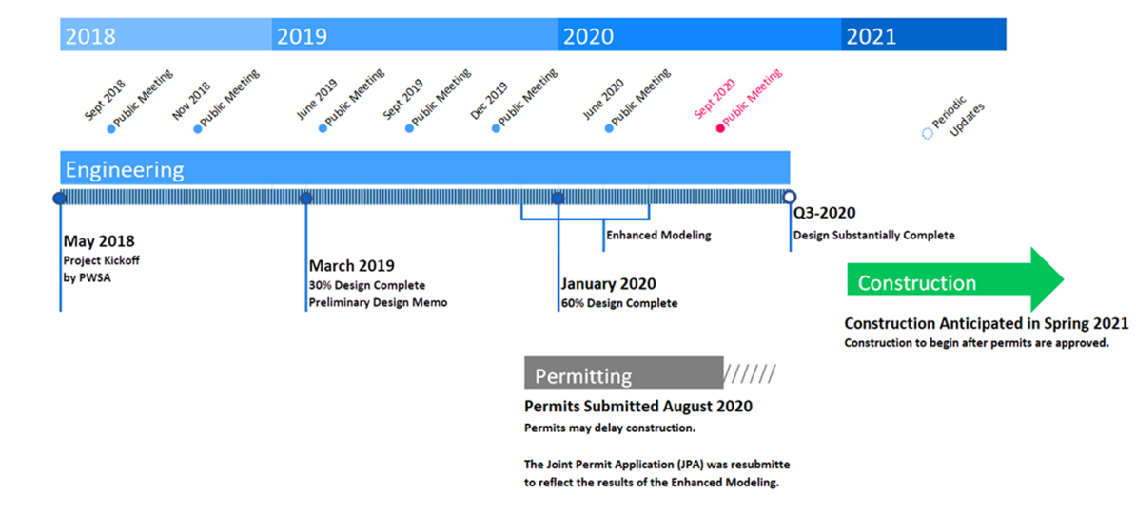
Project Schedule
28

Slide 29
Project Costs and Funding
Early Action Projects Design & Construction Costs
- Bridle Trail and Overlook Drive: $537,000
Project Costs: ~$28M
- Design, easement, permitting, and modeling fees: ~$7M
- Stream and Panther Hollow Lake and Dam: ~$1.5M
- 50-inch water relocation: ~$6M
- Stormwater pipeline: $10M
- Construction Management and Inspection: ~$2.5M
- Future maintenance costs for operation of system: $500,000 - $1M

Slide 30

6
Questions and Answers

Slide 31

Facilitating Today’s Q&A
Click the Chat Icon to ask a question
We will answer questions in the chat first
Located bottom of screen
Looks like cartoon bubble
Type question in dialogue box; press enter to send
All attendees and facilitators will see your question
Open Q&A Discussion
We will call on those with questions
Everyone will have a chance to speak
Speak politely; one at a time
You may continue to use chat feature to ask questions
For more information or to ask a question after the meeting, please visit www.pgh2o.com/4mr
32

